Slide 1
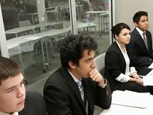
World Class Schools – Our 15th Year Will Be Our Best
New Programs, New Schools, It Is Still Fun, Free, and Easy To Do

Slide 2
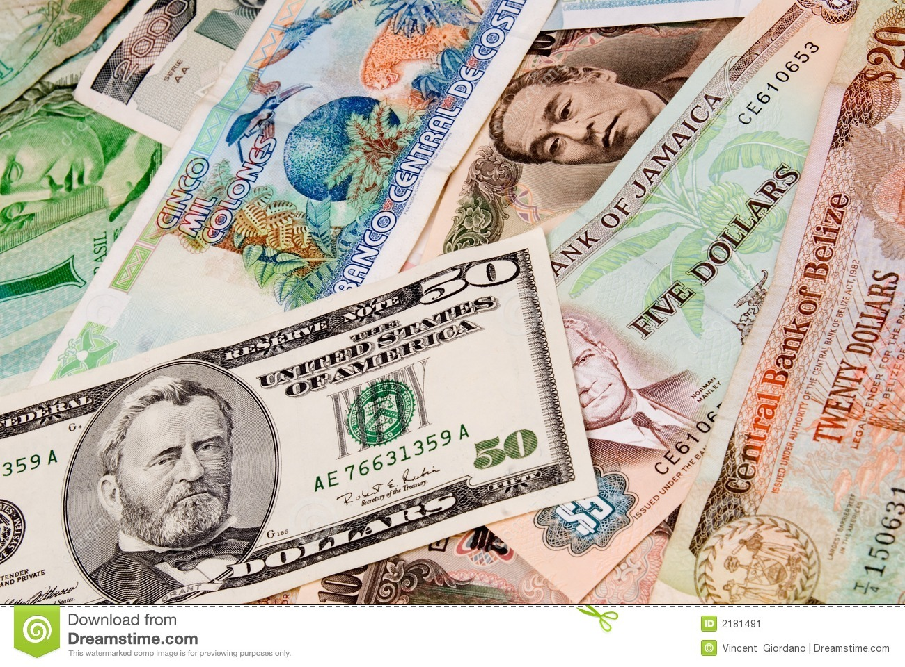
New This Year- Video Conferences That Make A Difference
In Our 15th year, we are out to make a difference by being the difference
We are working with Cities and Private Agencies To Make A Real Difference

Slide 3
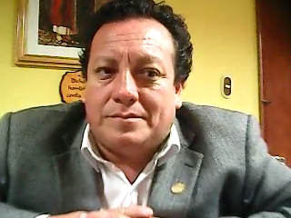
Working With The Mayor of Comas, Lima, Peru
To Raise Money For City Parks, Planting Trees, and Water for Children of His City

Slide 4
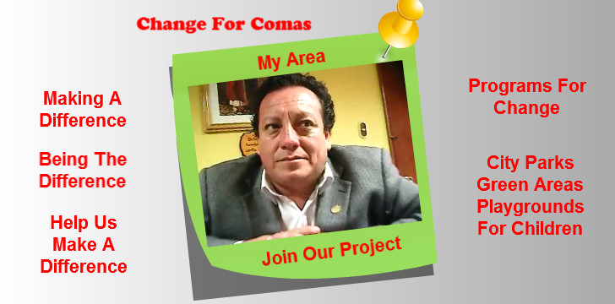
Be The Difference Help The Children
Video Conference November 2015

Slide 5

Fit 2 B Thai Virtual Martial Arts
Discipline, Dedication, Desire- Raising Money To Help Educate Orphan Street Children in Lima, Peru

Slide 6
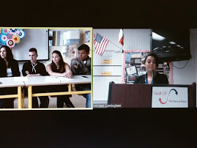
Special Once A Year Events
Join Us For These

Slide 7

The Great Alternative Energy Moot Court
March, April , May 2016

Slide 8
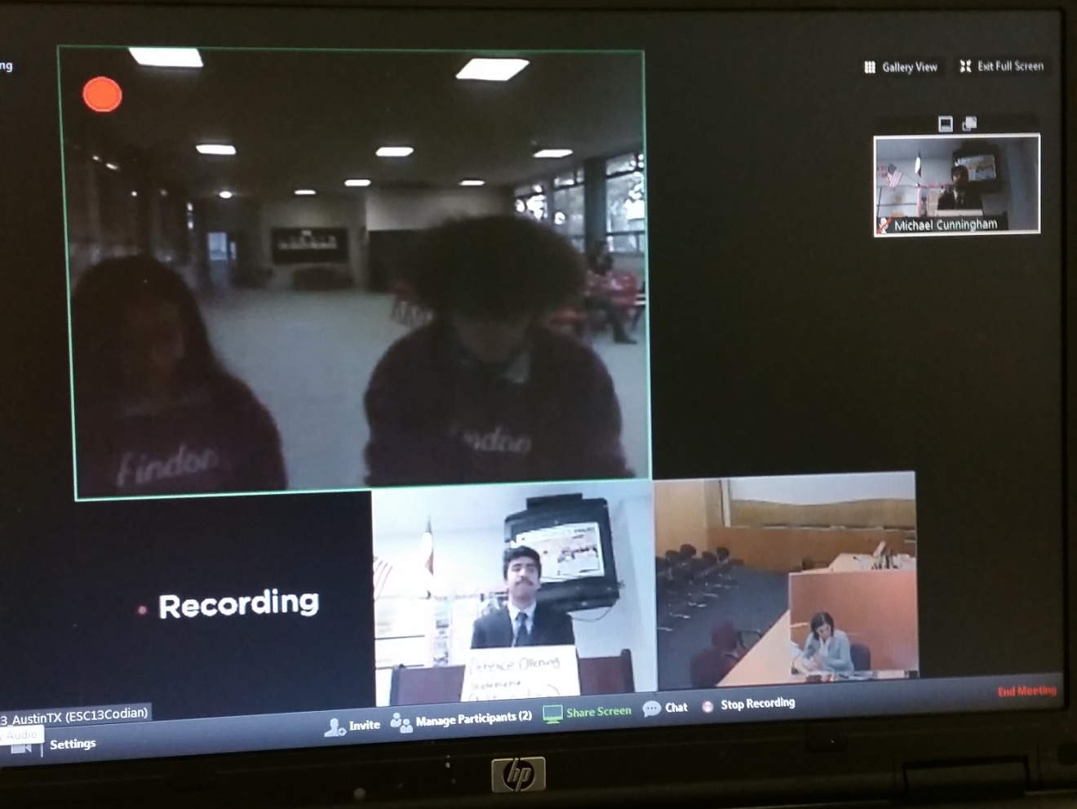
South Australia Moot Court
Feb., March 2016

Slide 9
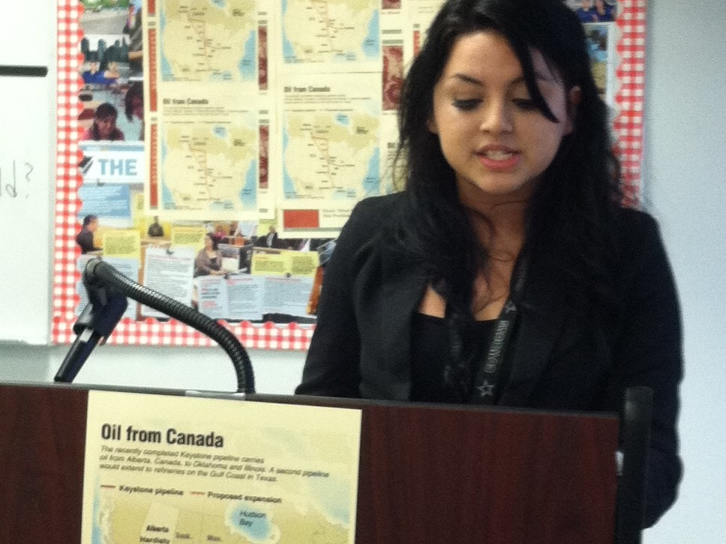
Law Day – International English- Moot Court
April 2016

Slide 10

Death Of The American Dream Moot Court
May 2016

Slide 11

International Criminal Court YMCA
Moot Court April 2016

Slide 12
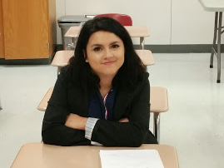
Law Day Espanol: Moot Court In Spanish
April 2016

Slide 13

The Great American Democracy Moot Court
May 2016

Slide 14
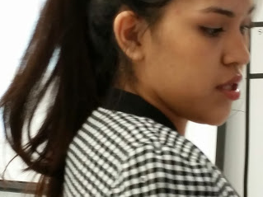
Monthly Events 2015-2016
Please Join Us

Slide 15
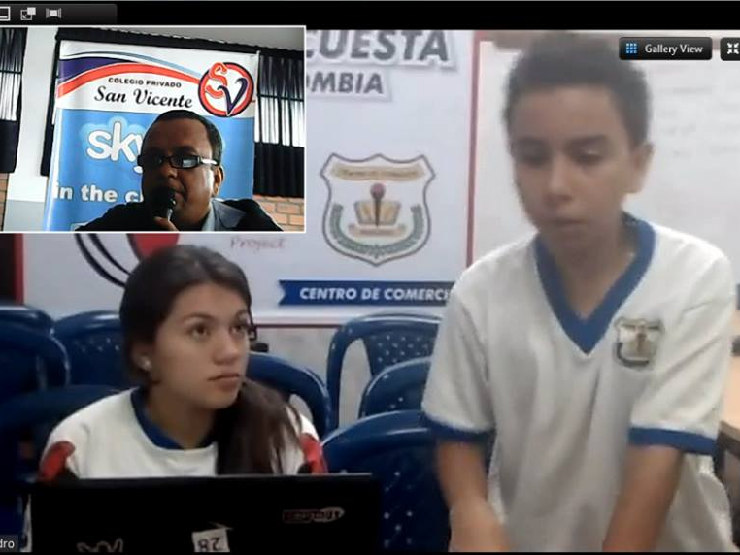
Food For Thought
Monthly Video Conferences On Food

Slide 16

Virtual Victuals
A Monthly Recipe Program

Slide 17

The Seoul Experience
Monthly Korean Language, Culture, and K Drama Discussions

Slide 18
Monthly Moot Court Trials
Please Join Us For These

Slide 19
Fit 2 B Thai Virtual Martial Arts
Discipline, Dedication, Desire

