Slide 1
The iPad: What to Do with One or an Entire Lab
Ruth Valle
Phyllis Manning

Slide 2
Let’s Take a Survey
Kahoot.it

Slide 3
Adobe Voice
Create fun videos with your photos that include music and narration.
Explain concepts.
Tell a story.
Great for student projects.
Free app.
http://voice.adobe.com/v/U8Dzb3naTRD

Slide 4
Green Screen by Do Ink
Place yourself or your students in front of any background of your choice.
Create virtual field trips to any location in the world.
Make videos or use still photos.

Slide 5
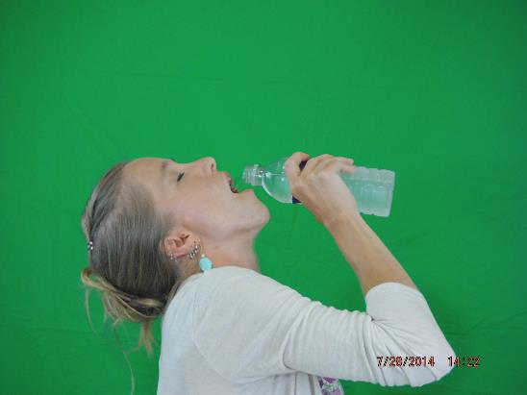
Green Screen Steps
Take photos in front of a large green screen.

Slide 6
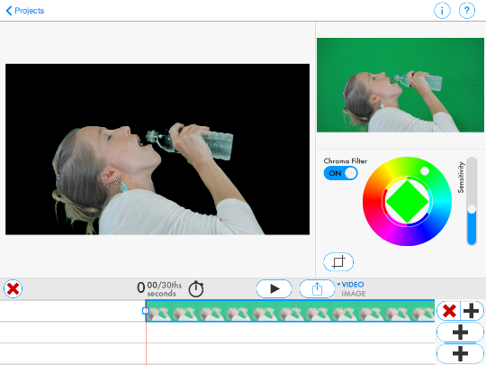
Green Screen Steps
Upload the photo by clicking on the first + sign on the bottom of the screen.

Slide 7
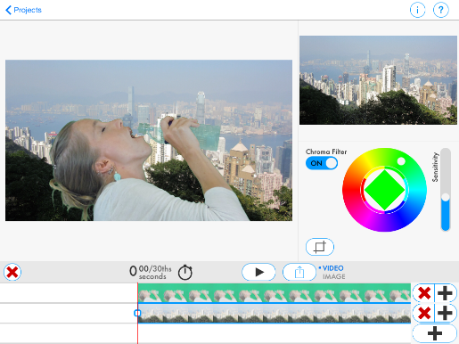
Green Screen Steps
Choose the new background for your photo from your photo gallery by clicking on the second + on the bottom of the screen.

Slide 8
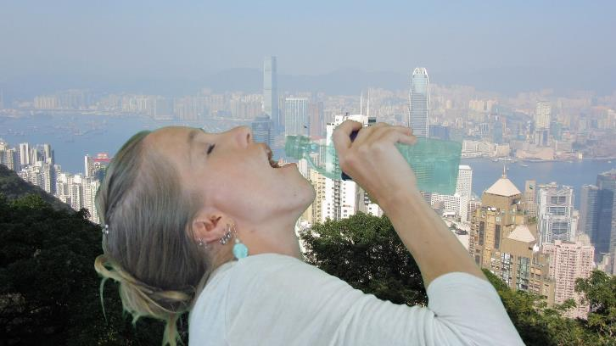
Green Screen Steps
Choose image or video depending on your project and upload.

Slide 9
Socrative
Use Socrative for formative assessments through quizzes, quick questions polls, exit tickets, and space races.

Slide 10
Socrative
A Poll
http://www.socrative.com
Student login
Room Number: 886260

Slide 11
Socrative Steps
Sign up as a teacher

Slide 12
Socrative Steps
Sign in to your teacher account.
Click on Manage Quizzes
Choose: Create Quiz
Name Your Quiz
Choose your format: Multiple Choice, True/False, Short Answer
Enter your question and check the correct answer.

Slide 13
Socrative Steps
You must choose the format for each question.
Save & Exit.
The quiz will appear in My quizzes.

Slide 14
Splashtop 2 Remote Desktop - Personal
Control desktop computers or laptops with the iPad.
The app allows teachers to access their computer from anywhere, even their home.
It allows teachers to walk around the room as they present their lessons.
It is initially free. (It is worth upgrading.)

Slide 15
Too Noisy Lite/Pro
Monitor the noise level in your classroom.
Adjust sensitivity settings from more to less (100% to 0%)
Choose from silent, quiet, group, class.
Pro offers more backgrounds.
Select the dial theme.
Classes are able to earn star awards.
Audible Alarm Options are available.

Slide 16
Intro Designer
Create intro movies, end credits, announcements, and more for your classroom.
Unique templates are provided (limited templates on Intro Designer Lite).
Change fonts, position of text, size and text captions easily.

Slide 17
Intro Designer Examples

Slide 18
Intro Designer Examples

Slide 19
Intro Designer Examples

Slide 20
Intro Designer Examples

