Slide 1
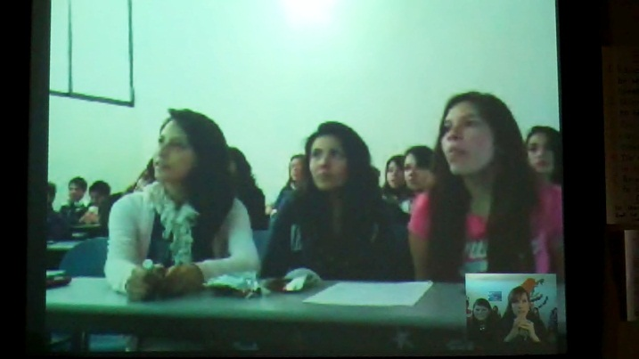
Setting Up Skype Talks With Other Classes or Speakers Around the World
The webinar will begin shortly. Stay tuned.

Slide 2
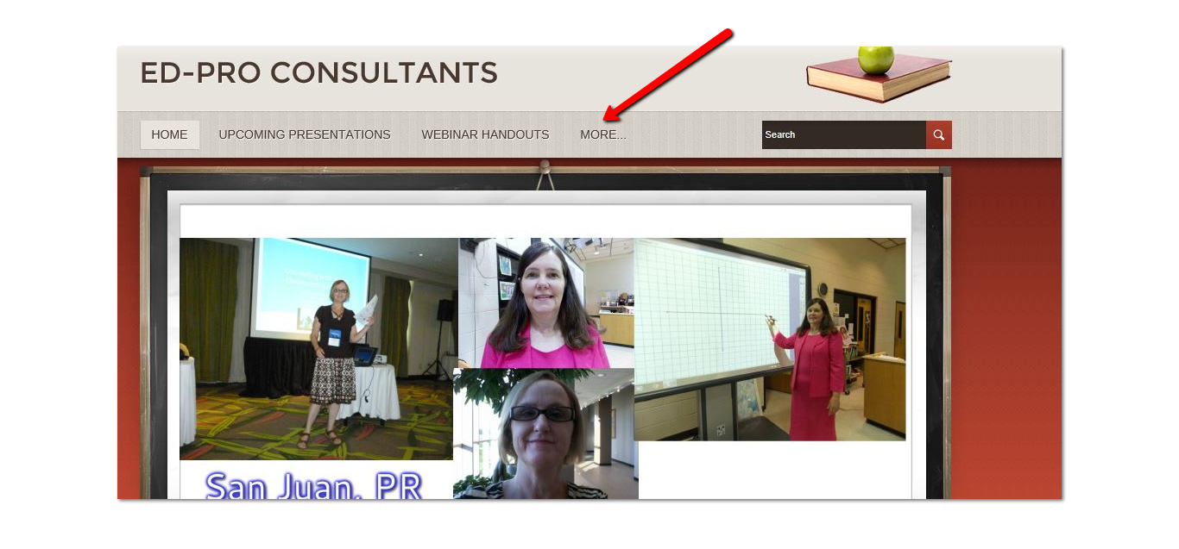
At the end of this webinar you will be directed to our website, where you can download this presentation and print your certificate of attendanceyour certificates

Slide 3
Recording of the webinar is strictly forbidden

Slide 4
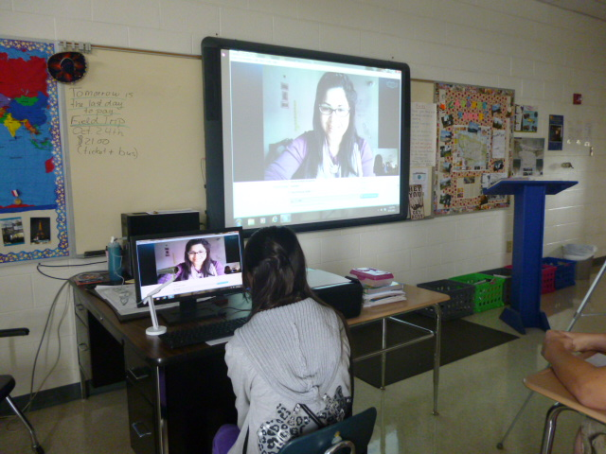

Skyping
Have you skyped before?
Have you ever thought of skyping with a foreign classroom?

Slide 5
Foreign Language Standards
Standard 5 for Modern Foreign Languages asks for students to participate in multicultural communities at home and around the world. Also, they are to show evidence that they use the foreign language for personal enjoyment.
Skyping certainly can cover this standard.

Slide 6
Can we skype from school?
You can use your personal laptop with webcam and microphone.
Or- buy a webcam for the school computer and an external microphone.
Be sure to hook up the laptop/computer to the Promethean Board so all students will be able to see.
Make sure you have some high quality speakers.

Slide 7
Finding Classrooms
How can we find a classroom to skype with us?
http://education.skype.com

Slide 8
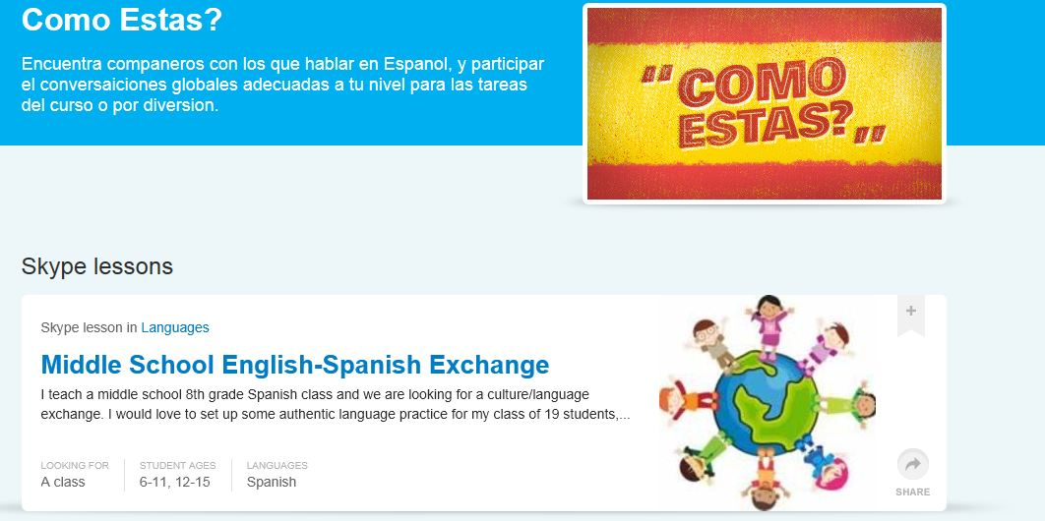
Join a Project or Create Your Own

Slide 9
How do you set up a session?
Post a project and teachers will contact you.
Request the teachers to add you as a contact.
Pay attention to when they come online- stay signed in on Skype-don’t worry; they will never call unannounced.
Start chatting with them on the instant messenger.
Use simple language to get started and get them to narrow down a time to skype with your class.
or- email them and discuss a date and time to skype

Slide 10
Recording Your Skype Conversation
Use recording software to record your Skype conversation for review after your talk.
Pamela
Or- videotape your conversation with a digital camera, but be sure to darken the room so the Promethean Board can be seen clearly.

Slide 11
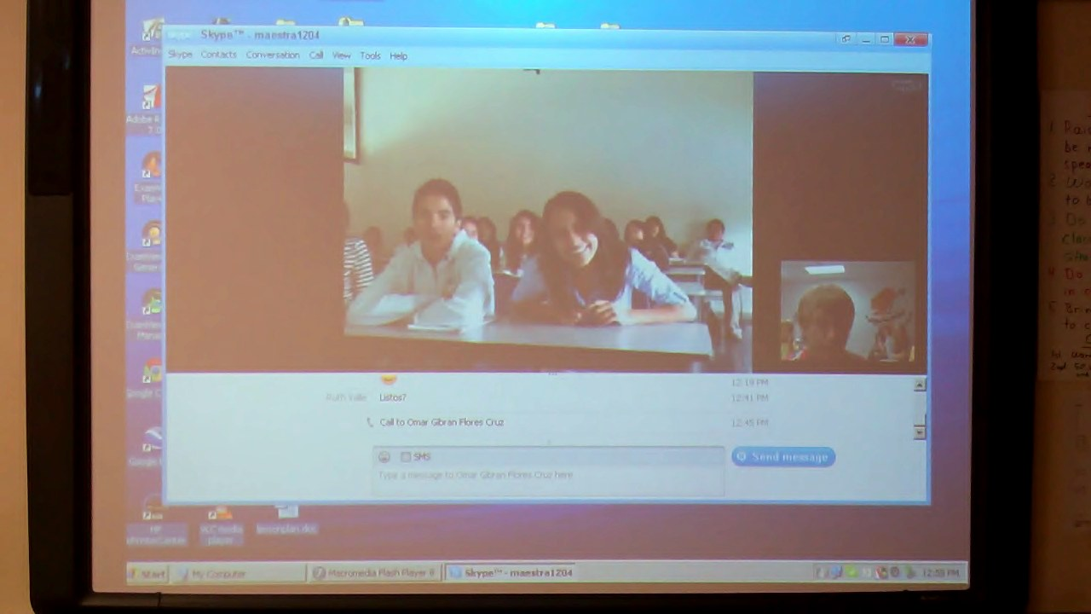
A 1st Skype session with a class in Mexico
Schedule a meet and greet session
Remember the time delay, speak slowly and clearly
Discuss what surprised the students the most about skyping with a foreign classroom.

Slide 12
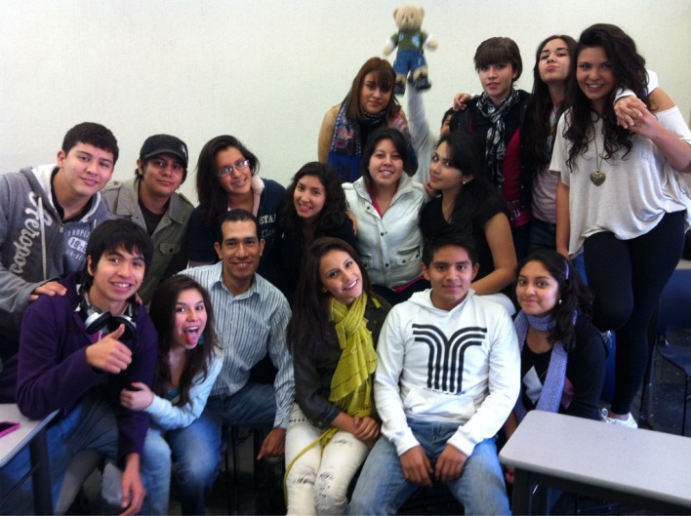
Quotable Quotes
How wild and crazy they acted
Spoke English so well
Clapped a lot
Teacher’s relaxed attitude about the skype
How similar they were to us-clothing styles, attitudes, music, hairstyles
Students had a very nice school
That our planned introductions went out the window and we ended up just chatting

Slide 13
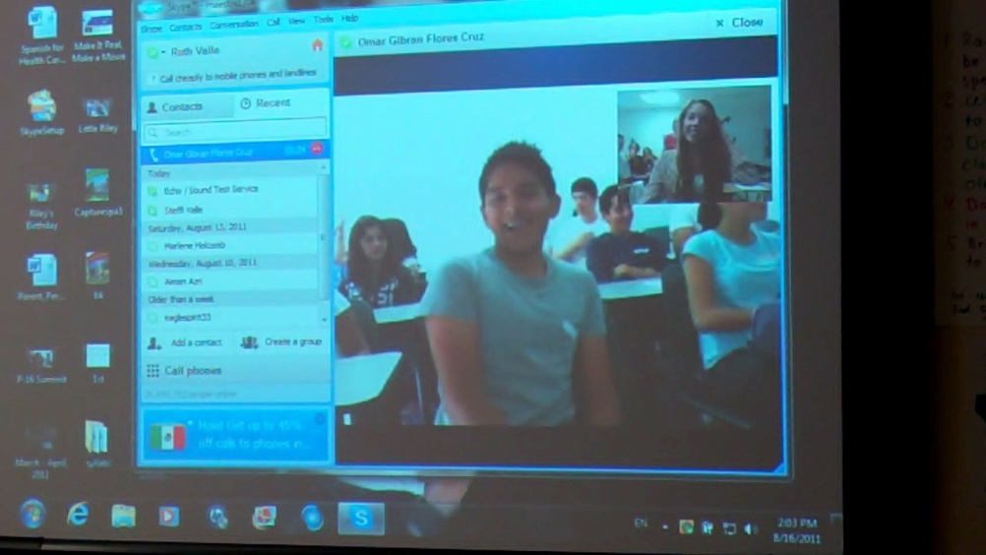
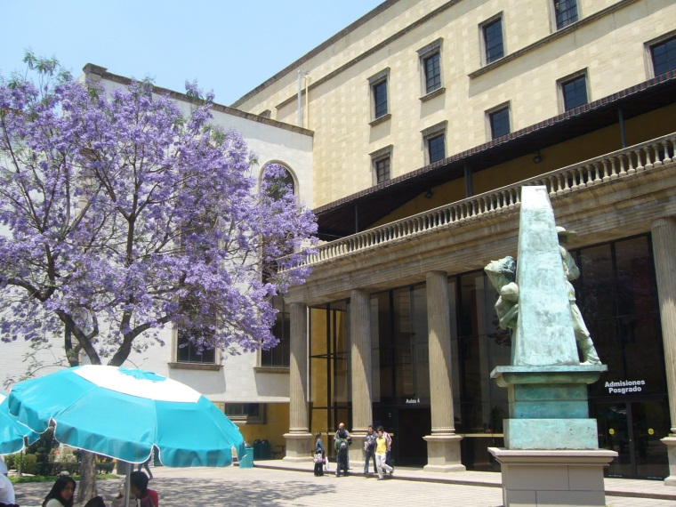
Quotable Quotes Cont.
That they had no fear to meet new people
Didn’t hold back and said anything they were thinking
Personal questions they asked
That they sang a song for us

Slide 14
The Project
Our project was to compare high schools from Spanish speaking countries to our schools.
We pulled their program of studies from their websites to compare with ours.
We generated a set of 15 generic questions to ask.

Slide 15
The Next Step
We then skyped with a school in Guatemala.
This school was an IB girls’ school.
The students were quite surprised about how different the girls behaved in Guatemala versus the students in Mexico.
After reciting a short poem to us and interpreting it for us in Spanish and English, they patiently answered all of our questions.

Slide 16
More quotables
The Guatemalans were more respectful and waited while someone was speaking.
Well behaved, spoke mostly Spanish, they let us talk.
Much more organized and an overall better experience than the skype to Mexico. We learned more about their culture and beliefs.
More polite, more formal.
We were more prepared this time, as were they.

Slide 17
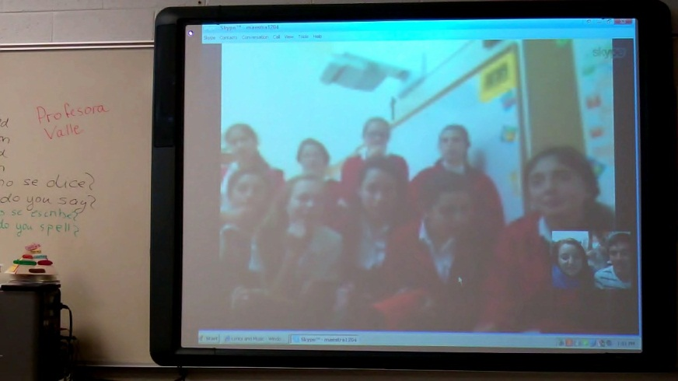
More quotes
The Guatemalans were wearing uniforms, while the Mexican students were wearing name brand clothing.
The Guatemalan class was more prepared to speak to us and had very good answers to our questions. They spoke in Spanish rather than English.
They were calmer.
They talked a lot…in Spanish.

Slide 18
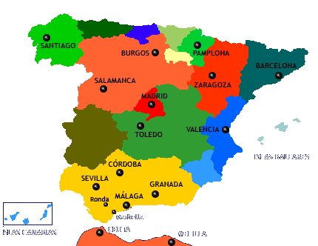
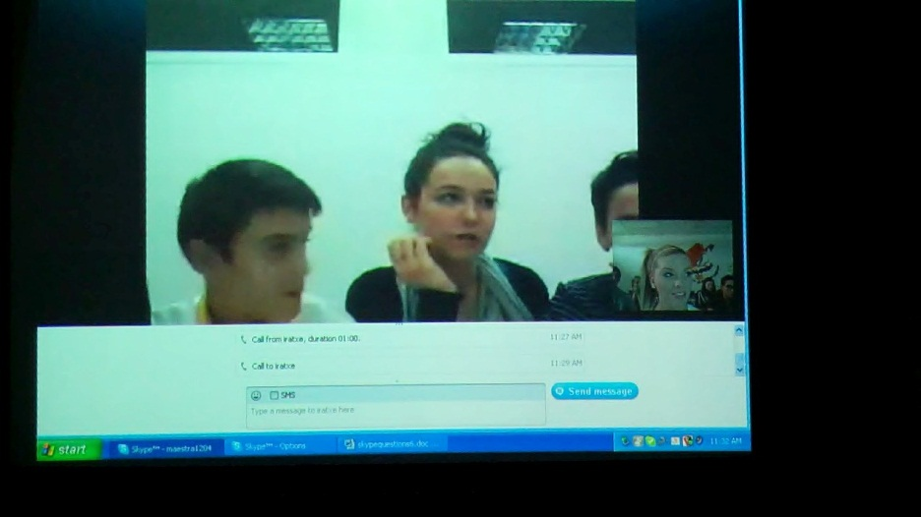
What was next?
We skyped with a school in Spain.

Slide 19
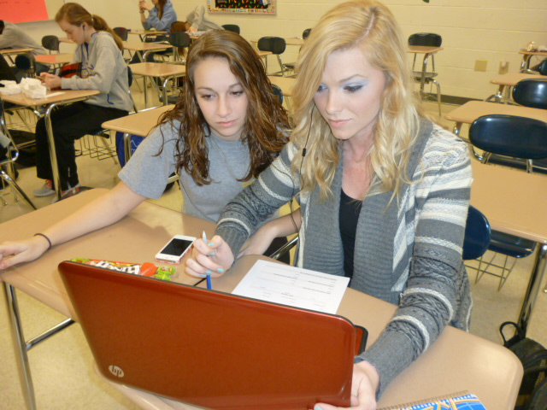
Part 2- Ibiza
More from Ibiza
Is band a sport?

Slide 20
Reaction to Skype talk to Spain
English is just as hard for them as Spanish is for us.
It was a good way to learn how people in other countries speak.
The girls seemed shy.
I liked watching their facial expressions when they didn’t understand us.
It made me want to learn Spanish more fluently.
Awesome, good sound quality
We learned about the difference in their pronunciation.

Slide 21
Project Conclusions
Schools require more foreign language classes.
There is greater interest/motivation in learning other languages.
They have similar interests and personalities.
They are very outgoing and enthusiastic.
They are very interested in our personal lives.
They are surprisingly comfortable with technology.
They have similar school schedules.
Nobody worked after school.
They have fewer breaks and vacations.
Soccer is clearly the most popular sport.

Slide 22
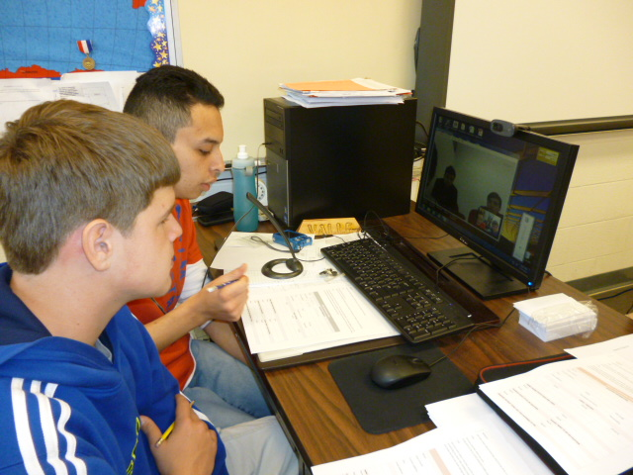
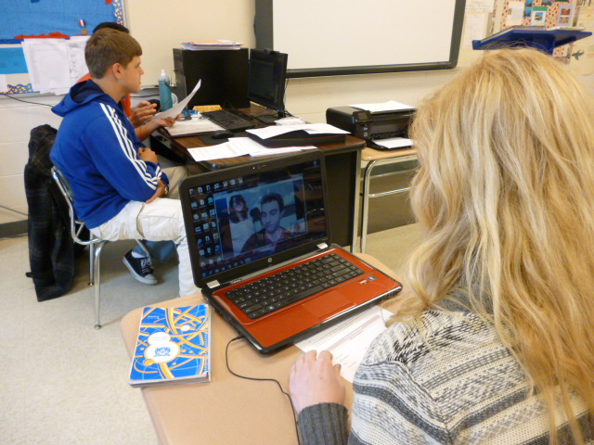
Be open to the possibilities
The teacher from Mexico invited us to do a Rally with his students.
4 teams from our school were supposed to compete with 4 teams from their school in a collaborative activity.

Slide 23
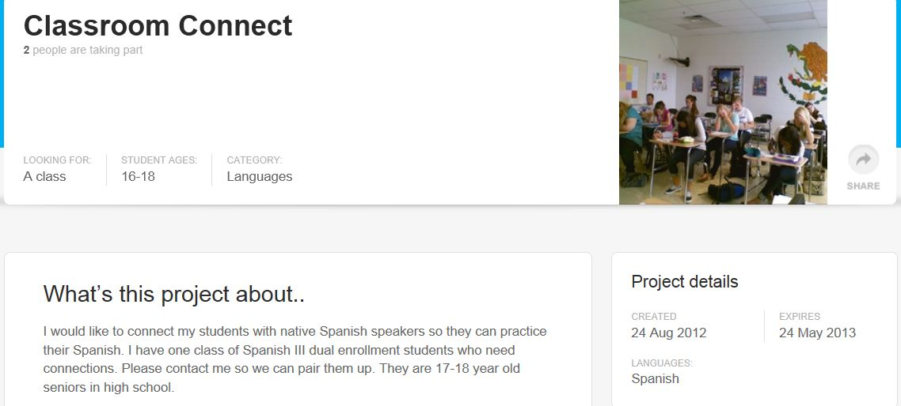
What’s next?-phase 2
Another project

Slide 24
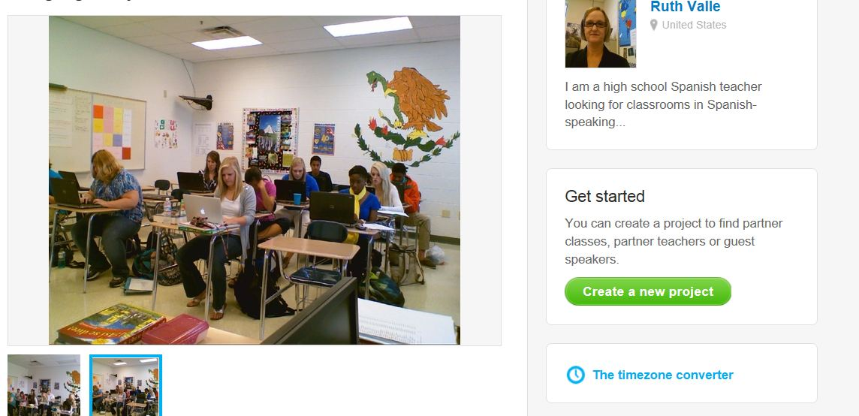
Phase 2

Slide 25
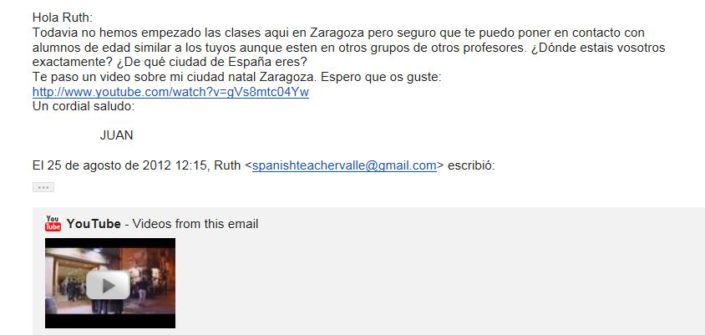
Gather contacts

Slide 26
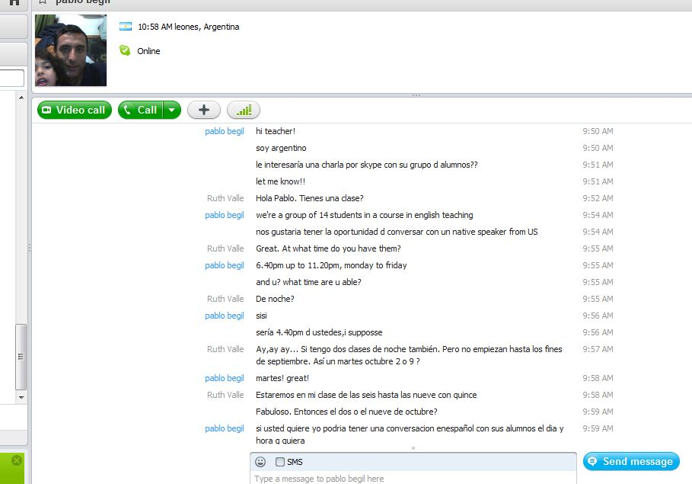
More contacts

Slide 27
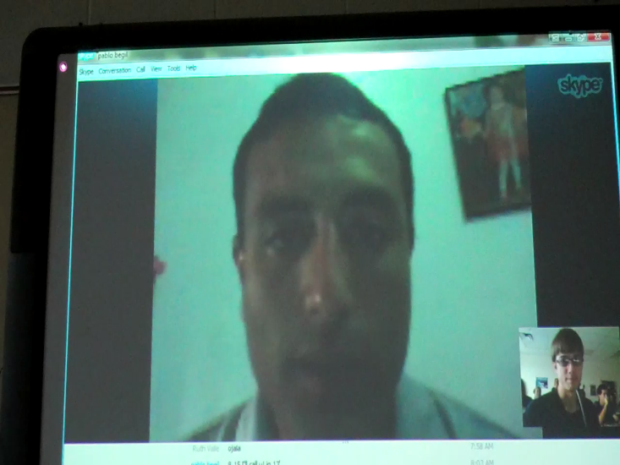
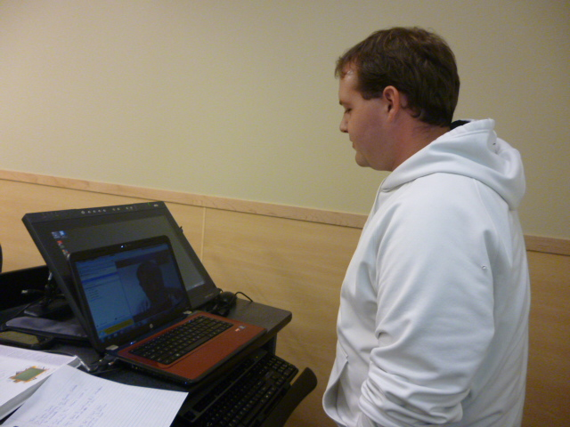
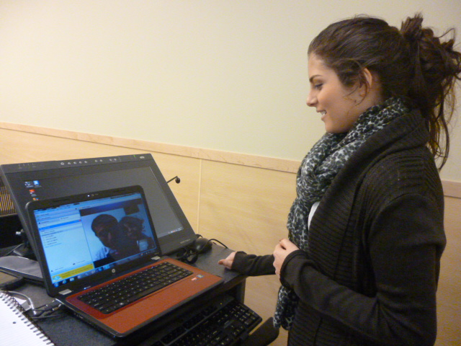
Pablo en Argentina

Slide 28
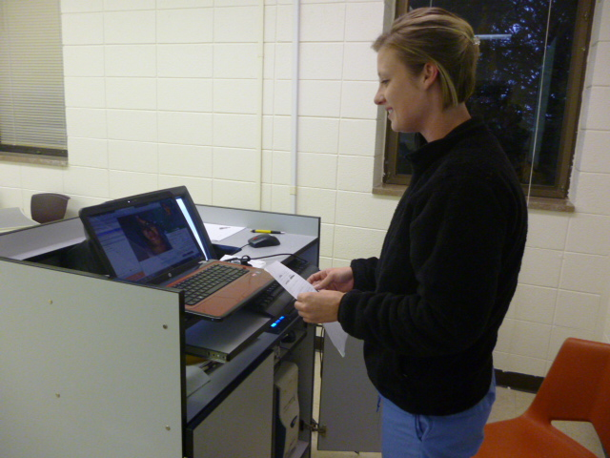
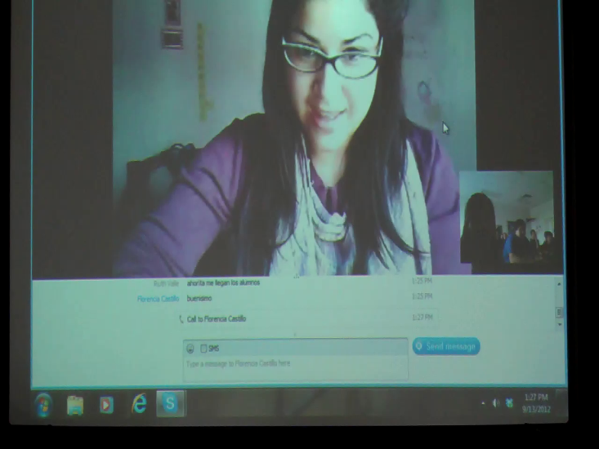
Florencia en Argentina
A cantar
muy linda la charla y espero que les haya gustado como a mi. Si alguno de sus alumnos quieren que los ayude a practicar el idioma, lo haria con gusto.
[1:48:38 PM] Florencia Castillo: Mucho gusto profesora! :)

Slide 29
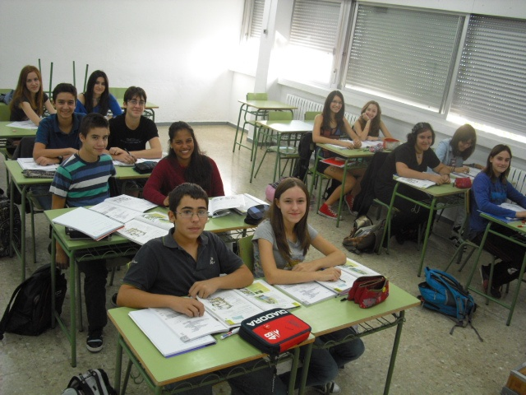
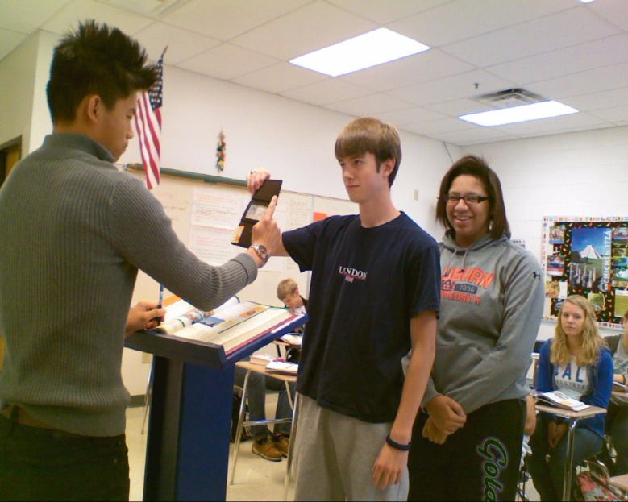
Email Pen Pals From Zaragoza
A virtual visit
Have students Skype individually on their own time

Slide 30
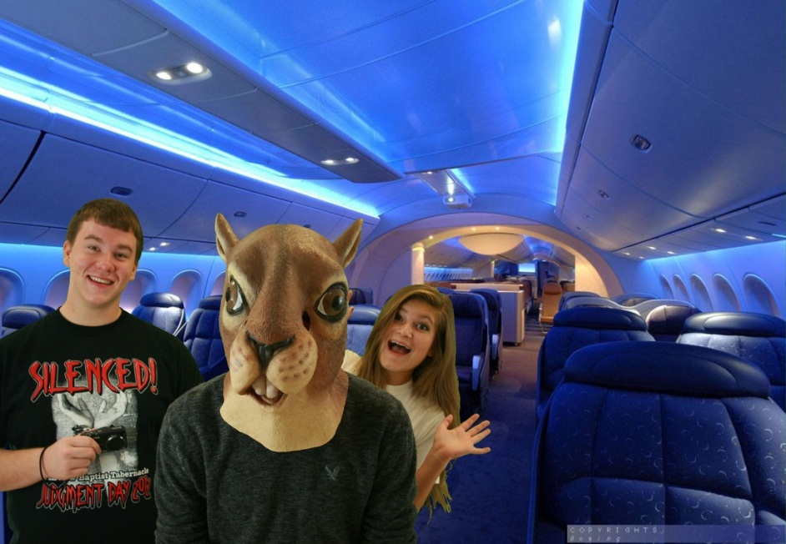
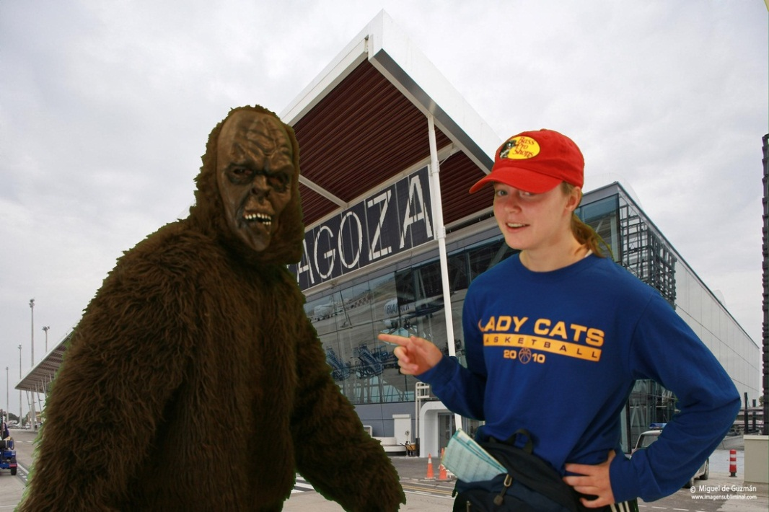
A Virtual Trip to Zaragoza, Spain

Slide 31
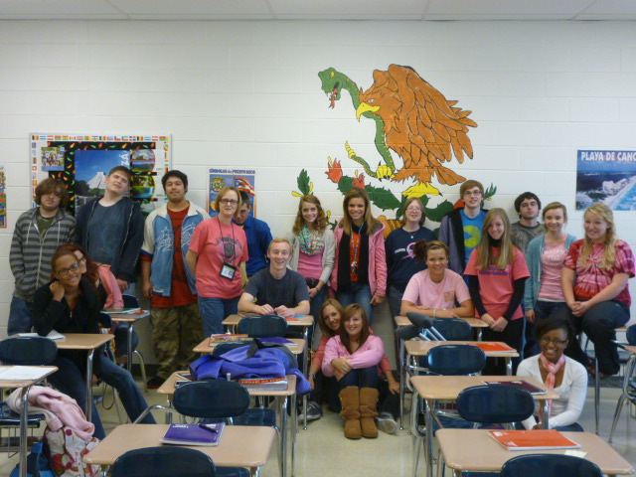
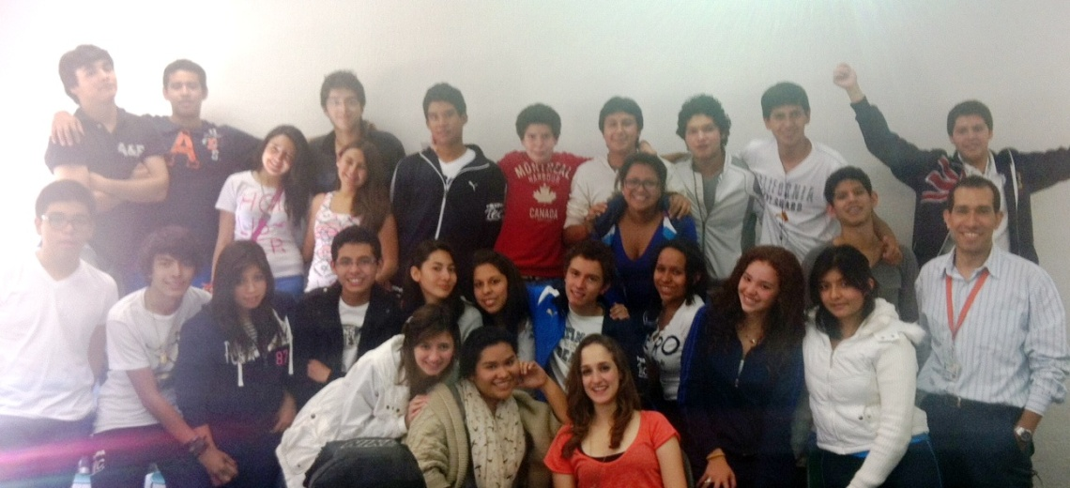
Still Talking to Omar’s Class

Slide 32
With whom will you skype?
Get set up on Skype and browse other teachers’ projects from around the world.
It will amaze you what they are doing.
Join an existing project or post your own and wait for responses.
Search for teachers by countries.
Or-Contact top people in your field on their websites and see if they would like to skype with your class.

Slide 33
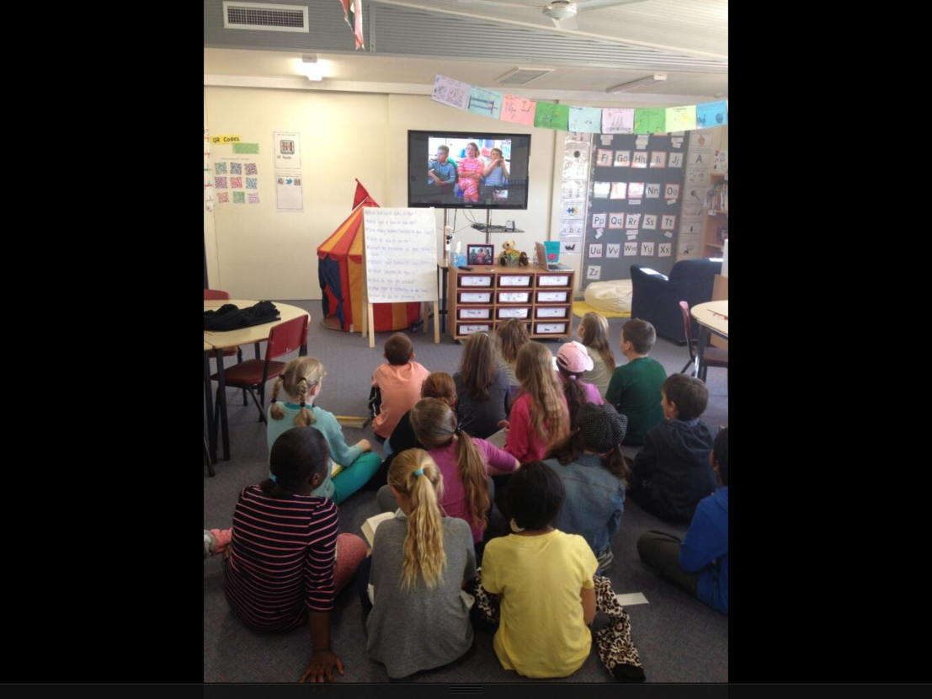
Follow @SkypeClassroom on Twitter

Slide 34
Resources and Bibliography
For Research on Skyping in classrooms read Sarah Eaton’s paper on Skyping
http://tinyurl.com/o67w5dp

Slide 35
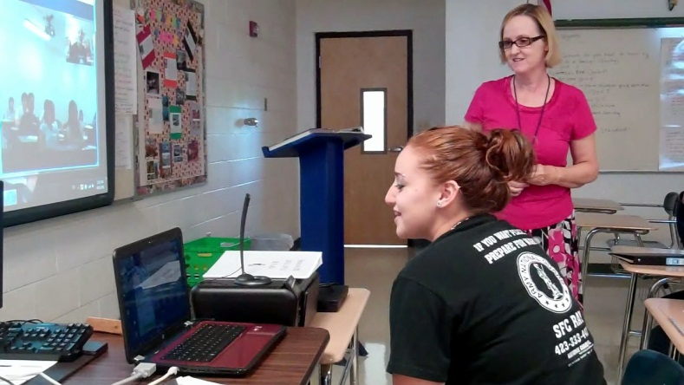

Skyping Out
Thank you for participating in our webinar.
Questions or concerns?
http://edproconsultants.weebly.com

