Slide 1
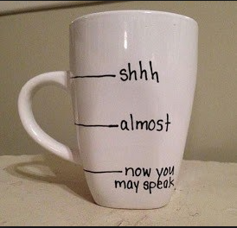

Slide 2
Bridging the Gap
Between Engagement and learning

Slide 3
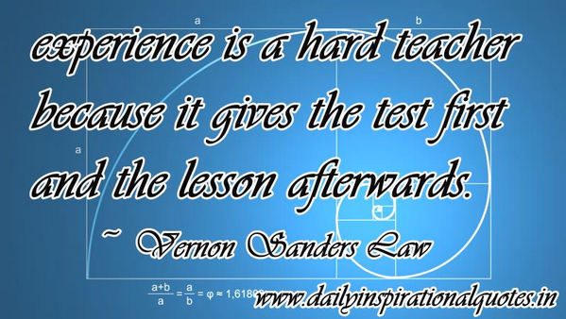
Student Engagement
30
20
45
55

Slide 4
Teaching is a gift that seems to come naturally for some, others have to work overtime to achieve a great teacher status.
Yet the payoff is enormous –
for both you and your students
Notes:
Let me tell you that it was and still is not an easy task for me. I can see some of you think….. Now his accent sounds familiar… Where have I heard it? Where? Where? Where? King Julian From Madagascar. Raj from Big Bang Theory… No wait!!! I got it… He sounds just like the Dell Customer Service Representative, except he did not change his name to Andrew or Steven.

Slide 5
#ILOVEDELLCUSTOMERSERVICE
Ummmmmmmm
NOT!!!!!!

Slide 6
What do we know from our own experience
Attention span is very small and getting smaller.
Students are tied to their digital devices.
Student who participate
in class do better
They want immediate, direct, concrete experiences rather than learning concepts first and applying them later.

Slide 7
Stereotyping the Millennials
It is critical to understand that Millennials behave differently, and need different types of solutions to stay engaged.
The Millennial generation has been the subject of both criticism and praise, with the same personality traits observed in different lights to paint two very different pictures.
Info: How to train Millenials, MindTrickle

Slide 8
Stereotyping the Millennials
Where some see “entitlement”,
others see
“healthy self-confidence”,
among other traits with opposing interpretations.
Info: How to train Millenials, MindTrickle

Slide 9
Our Perspective vs Theirs
One criticism of Millennials is that they lack the unwavering work ethic of previous generations.
70% of Millennials say they are unwilling to endure unpleasant workplace conditions just to achieve career success.
This isn’t due to a lack of ambition.
65% said that success in a high-paying job is one of the most important achievements they hope to make in their life.
Info: How to train Millenials, MindTrickle

Slide 10
Our Perspective vs Theirs
We must look beyond negative stereotypes about Millennials and try to understand them as unique individuals.
Info: How to train Millenials, MindTrickle

Slide 11
1. Millennials Are Motivated by Meaning.
2. Millennials Challenge Hierarchical Structures.
3. Millennials Want a Relationship with Their Teachers.
4. Millennials Are Tech Savvy, To Say The Least.
5. Millennials Are Open to Change.
6. Millennials Are Task (Not Time) Oriented.
7. Millennials Have a Hunger for Learning.
Dear good God!!
I hope it is not that kind of a relationship
10 Characteristics of Millennials
Info: How to train Millenials, MindTrickle

Slide 12
How do we help our students develop the skills necessary to focus their attention on our classes?
We need to engage the students in ways that make it difficult for them to pay attention to anything else.
There are two benefits for this:
Students remember more
Students seem more prepared for class

Slide 13
Looking for the magic formula?
There is none…..

Slide 14
Make your students Teacher Proof instead of Teacher Needy

Slide 15
Exploring Creativity In the classroom
Encourage
Risk-taking
Embracing
Ambiguity
Accepting
Change
Fostering
Self-discipline
Promoting
Trust
Nurture creative thinking.
Stimulate generating both divergent and convergent ideas.
Provide reassuring and positive constructive feedback during the activity.
Allow time for contemplation of ideas.
Encourage expressions of appreciation for creative contributions by collaborators on a project.
http://edex.adobe.com/resources/7b204577/?

Slide 16
The 3D approach
Strategies that help engagement and thereby learning
The most effective teachers vary their styles depending on the nature of the subject matter, the pace of the course, the intensity and volume of the information and several other factors.
This forces students to do their best at all times throughout the course.
Use the three D approach:
Directing – tell students what to do.
Discussing – Ask questions and listen.
Delegating – Empower students.
Paul Thornton, Faculty Focus, September 30, 2013

Slide 17
The ‘Re’ Approach
Strategies that help engagement and thereby learning
Repeat
Revise
Refresh
Reflect
Retain

Slide 18
Strategies that help engagement and thereby learning
L-T-W-P-S Approach
Listen
Think
Write
Pair
Share
Image: Microsoft theme. The Lighthearted Professor, Positive Psychology, Teaching Professor Conf. Atlanta

Slide 19
Strategies that help engagement and thereby learning
L-T-W-P-S Approach
Discussion Forums.
Worksheets/Group project.
Allow controlled chaos.
Promote discussions.
Take cognizance of the introverts.

Slide 20
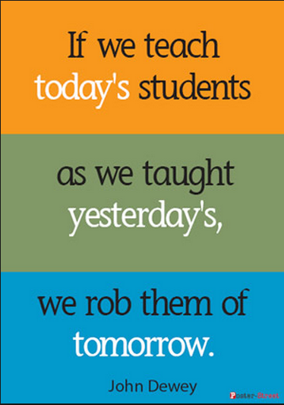
PBL - Approach
Promotes higher order thinking.
They see the application (Millennials Are Motivated by Meaning).
They learn to analyze problems (logical reasoning)
They learn to filter information.
They learn to apply critical thinking skills.

Slide 21
The Wagon Wheel Approach
Ask questions and require students to write responses. A quiz maybe or just a card. Read the relevant answers or the ones that need explanation
Have students respond to questions about reading or a previous class activity and bring those answers to foster peer discussions.
Craft mini-lectures to include time for student comment, feedback and response.
Focused learning.
Create rapport with students and build a classroom.
Need
Problem
sets
I
got
this
Need
Review
Grey
Areas

Slide 22
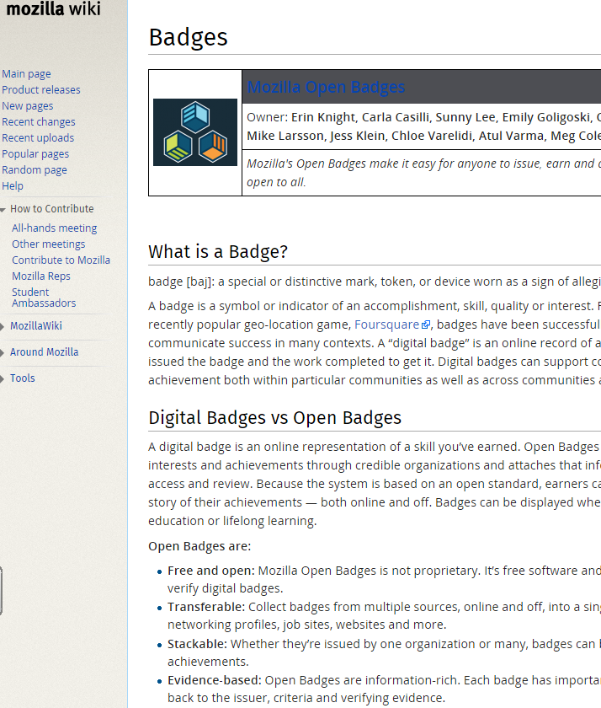
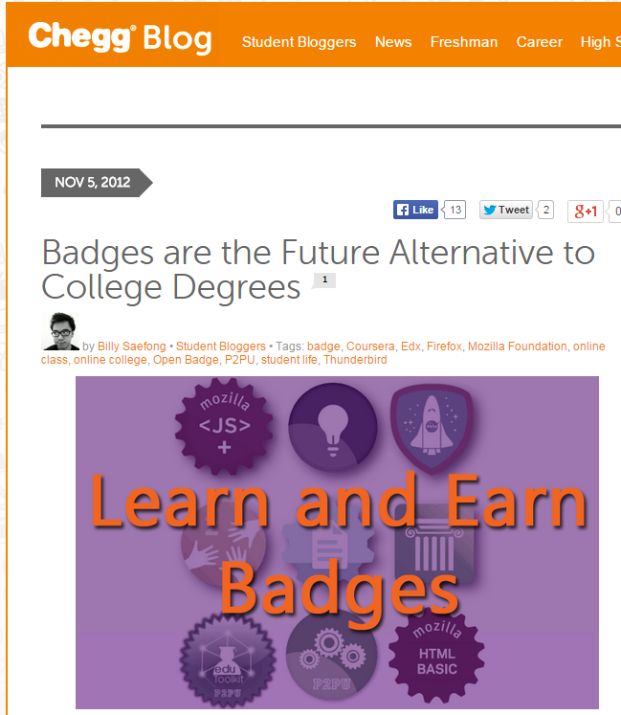
Create Badges for your students based on their knowledge, skills, etc.
Millennials Want a Feedback

Slide 24
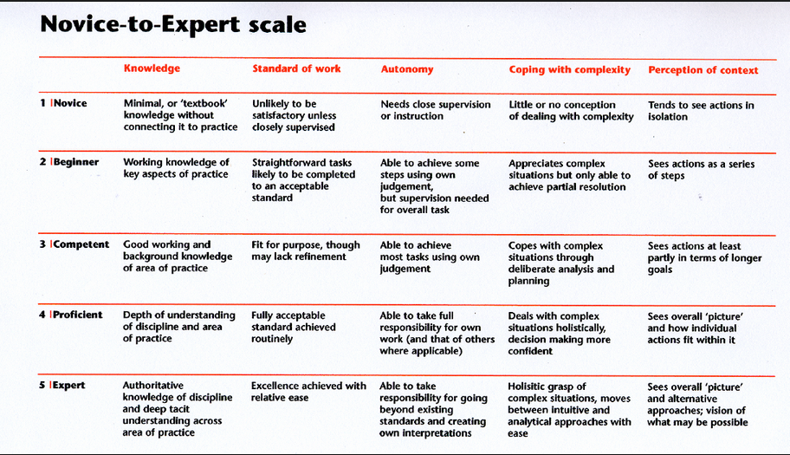

Slide 25
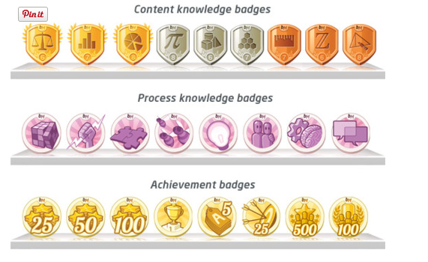
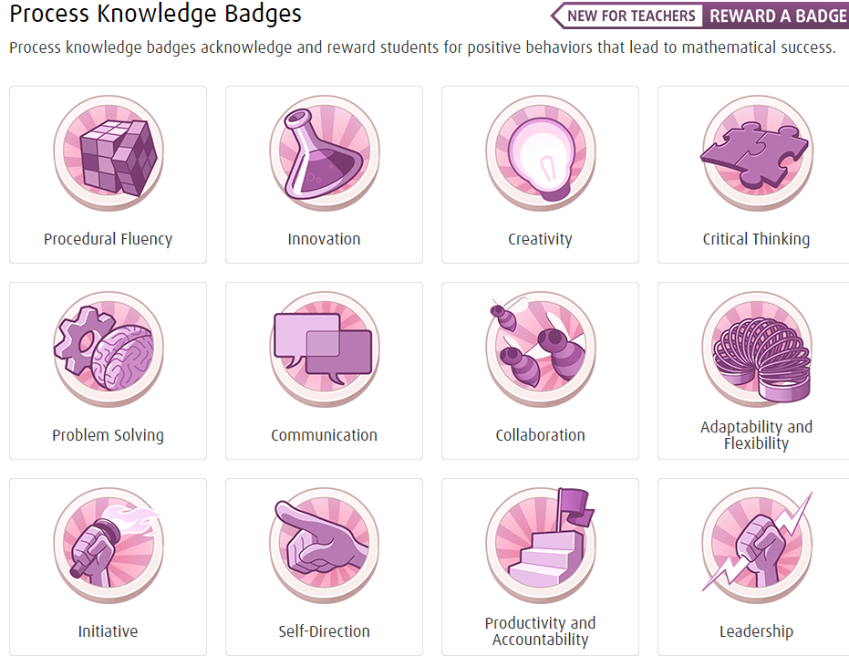

Slide 26
If you want students to develop, ask and attempt to answer their own questions, then we have to quit asking the kinds of questions teachers typically ask.
Ask questions that interest and puzzle them.
Re-reading does not help for long term memory. When they hunt for the answers, they remember it for long.
Teach them how to look for a deeper meaning or understanding
Create a competitive atmosphere.
Make it a fun class.
Millennials Have a
Hunger for Learning
Millennials Are Motivated by Meaning
Millennials Crave
Constant Feedback

Slide 27
Set and communicate the purpose of your course content
Context is critical for Millennials.
If Millennials can find a purpose, they are willing to invest in it.
If they are interested in engaging and contributing, they will give feedback proactively.
What will they get out of it?
Millennials want to know exactly what they will be learning, how the lessons will be delivered, how they will be assessed on this knowledge, and how this relates to their future job or career path.
Notes:
Why should they do this training?
Context is critical for Millennials.
If Millennials can find a purpose, they are willing to invest in it. If they are interested in engaging and contributing, they will give feedback proactively.
What will they get out of it?
Millennials want to know exactly what they will be learning, how the training will be delivered, how they will be assessed on this knowledge, and how this relates to their job or helping them do better in their respective roles.

Slide 28
Draw Your Millennial Audience In With an Effective Pull
Structure the course into meaningful topics.
The topics should communicate the scope of the course and also make progressing through the course intuitive and meaningful.
Provide clarity on these expectations up front and allow them to ask questions.
Create discussion forum exchanges.
Introduce Desirable difficulty.
Millennials want to receive regular feedback from their teachers

Slide 29
Invest in Delivering Flexible and Well Structured Training Content
Using technology is like breathing air to Millennials – it just comes naturally.
Technology brings flexibility to learning programs.
Harness technology to drive engagement.

Slide 30
Use Periodic Quizzes to Evaluate Progress – “Test to Teach”
Test to teach is all about using periodic quizzes during the program to enhance student learning and adjust instruction during the program.
Periodic quizzes make learning more active, engaging, and purposeful – very important factors in keeping Millennials motivated.

Slide 31
S-S-S
Start small – make adjustments to your teaching.
Start slow – be comfortable before you take a leap.
Start smart – think of what works for your class and change accordingly.

Slide 32
POINT 1
REMOVE CRUTCHES
POINT 2
INTRODUCE DESIRABLE DIFFICULTY
POINT 3
MIX PULL AND PUSH
LEARNING LEDGE
POINT 4
ACTIVE, ENGAGING, AND PURPOSEFUL
POINT 5
TEST TO TEACH

Slide 33
Acknowledgements
Ruth Valle
Phyliss Manning of
EdPro Consultants.
My Peers, Colleagues and Friends of Monroe County and Hiwassee College
South College
Acknowledgements
Articles from
Teaching Professor’s Conference, Atlanta
Faculty Focus (2013-2015)
5 tips to successfully engage your online learners, iSpring, May 2015.
Adobe Education Exchange
Campus Technology
Google Images
Microsoft Theme

